Slide 1
Drug Mortality and Socio-Economic conditions in Connecticut
Sandhya Govindaraju, Monica James, Yayun (Aaron) Liu, Alisha Pandhi

Slide 2
Project Description
We were looking to analyze trends in drug overdose death rates in Connecticut by:
Income
Age
Education
Gender
Geo-location (counties)
Unemployment rates
Barriers to medical treatment
Drug

Slide 3
Data Sources

Slide 4
Struggles with data
We were not able to find reliable data to analyze and plot these trends:
Drug-induced mortality rates and income
Drug-induced mortality rates and education

Slide 5
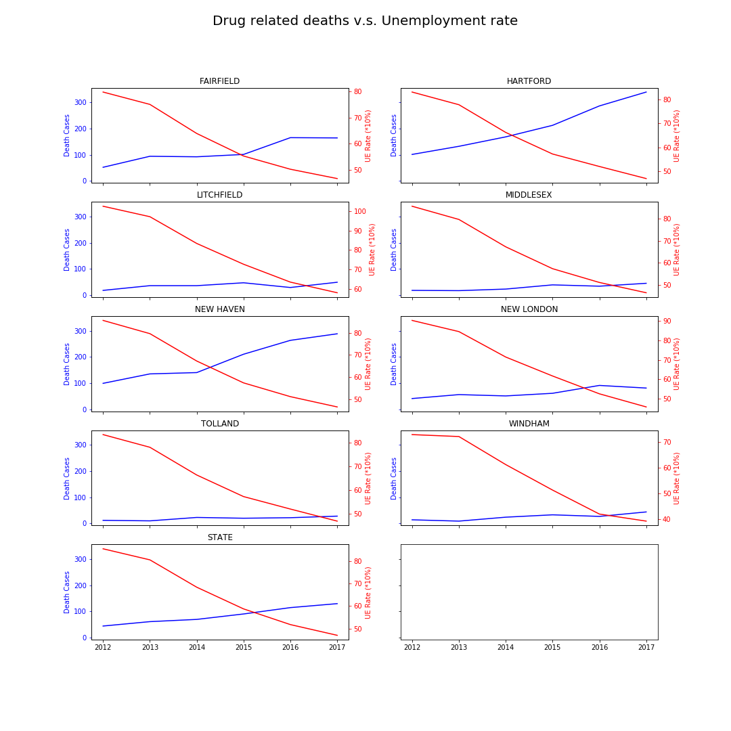
Drug-induced Mortality and Unemployment rates

Slide 6
Drug-induced mortality rates and barriers to medical treatment

Slide 7
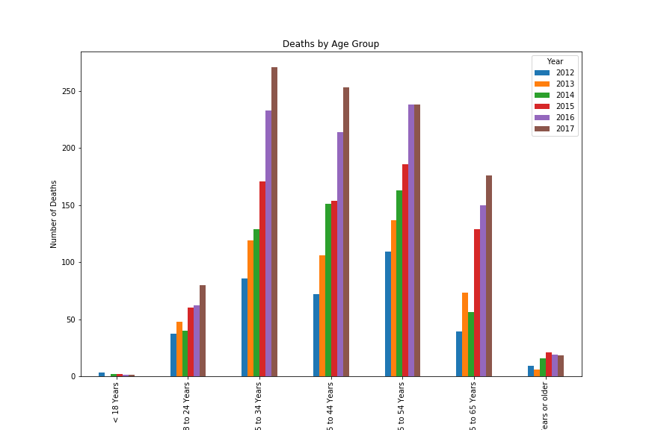
Drug-Induced Mortality Rates and Age

Slide 8
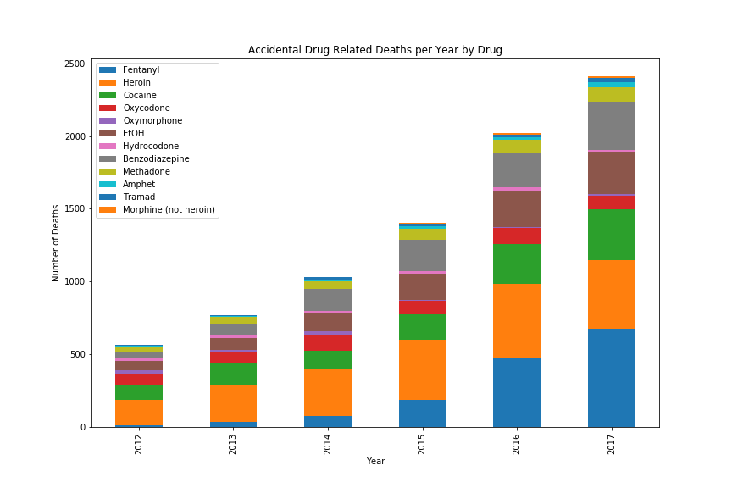
Drug-Induced Mortality Rates by Drug

Slide 9
Fentynal

Slide 10
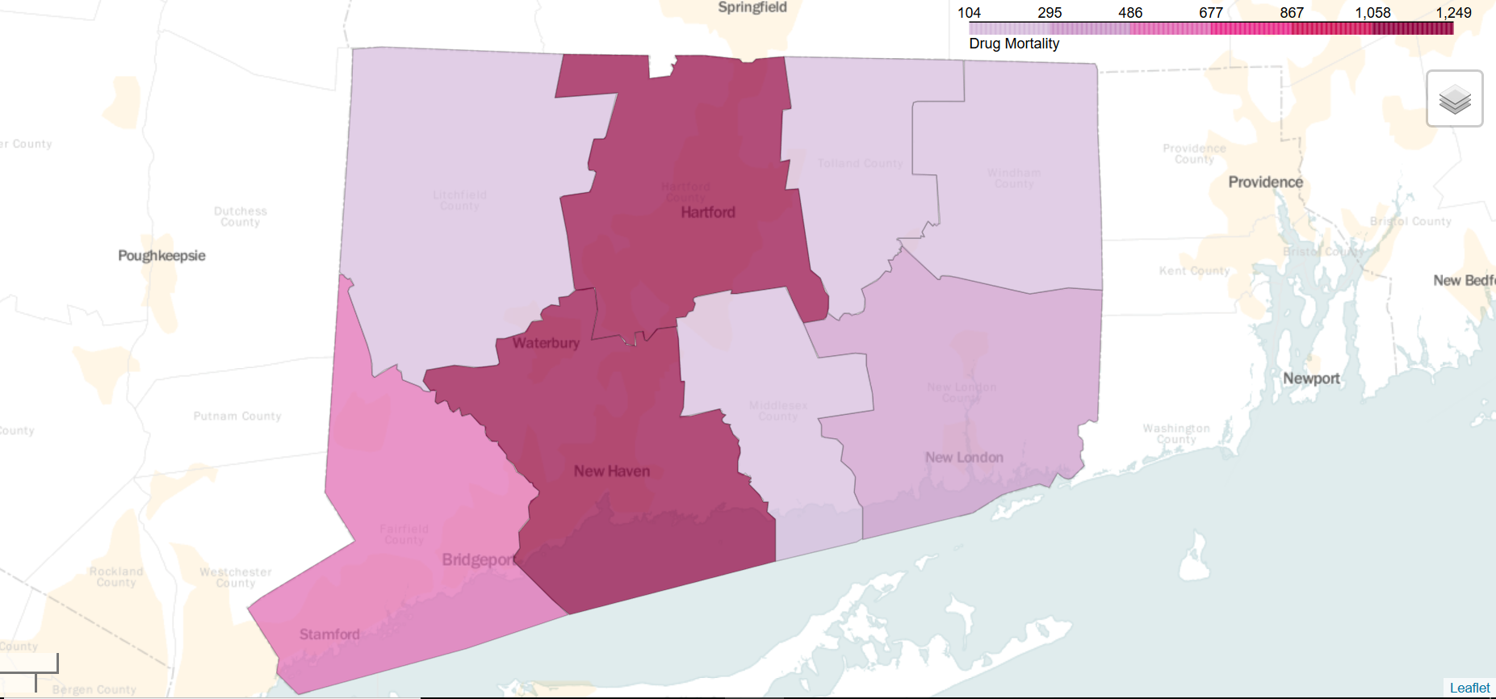
Drug-Induced Total Mortality by County

Slide 11
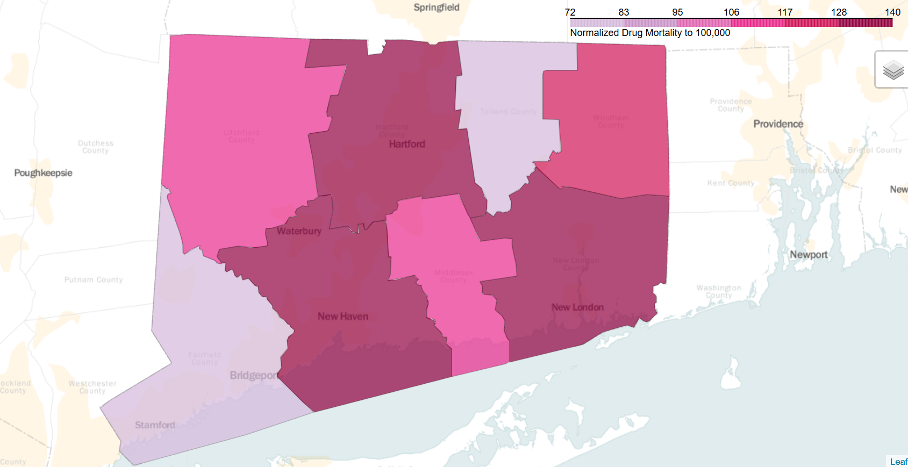
Drug-Induced Mortality by County per 100K

Slide 12
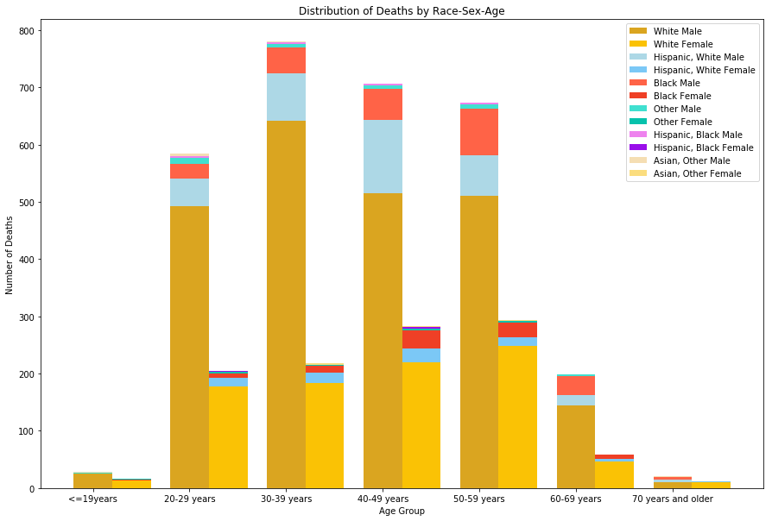
Drug-Induced Mortality by Gender, Race, and Sex

Slide 13
Drug-Induced Mortality by Gender, Race, and Sex
Age Group | Population % | Expected | Observed
20-29 years | 19.88 | 584.8696 | 584
30-39 years | 18.61 | 547.5062 | 780
40-49 years | 23.98 | 705.4916 | 706
50-59 years | 22.71 | 668.1282 | 673
60-69 years | 14.82 | 436.0044 | 199
Total | 100 | 2942 | 2942
Chi-Squared Test p-value: |  | 4.34786E-48
Race | Population % | Expected | Observed
White | 71.2 | 2904.248 | 3242
Hispanic White | 6.3 | 256.977 | 432
Black | 9.4 | 383.426 | 329
Hispanic Black | 0.8 | 32.632 | 17
Asian | 3.8 | 155.002 | 14
Other | 8.5 | 346.715 | 45
 | 100 | 4079 | 4079
Chi-Squared Test p-value: |  | 9.3448E-120
Chi-Squared test on both cases gives a p-value of almost 0, rejecting null hypothesis. (Some groups are affected more than others).

Slide 14
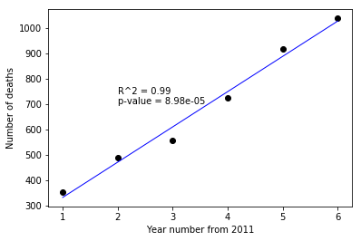
Drug-induced Mortality by Year
Fitting linear regression:
Independent variable: Year number
Dependent variable : Number of deaths in that year
Intercept = 193.33, Slope = 139
Prediction for 2018 = 1166 deaths

Slide 15
Conclusions
Drug related mortality is expected to go up year-over-year.
Fentanyl is fueling the increase.
Some groups (Males; White and Hispanic White; 30-39 age group) are affected disproportionately.

Slide 16
Questions?

